Slide 1
Electro-Mechanical Relay
By: Mabel Olson

Slide 2
Overview
What is an electro-mechanical relay?
What are the components?
How does it operate?
What is the theory behind the operation?
What are the types?
What is the application?

Slide 3
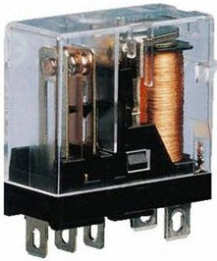
Electro-Mechanical Relay
An electromechanical relay is essentially a switch that converts electric energy to mechanical energy to either connect or disconnect another circuit depending on the type of relay.

Slide 4
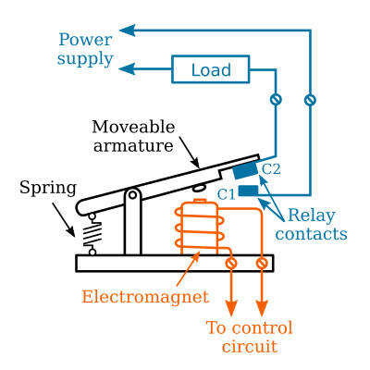
Components
Coil
Armature
Spring
Contacts
Notes:
Coil – The coil is an inductor or a length of wire that is wrapped around a magnetic core. When a current is passed through it a magnetic field is produced.
Spring - The holds the armature in a specific initial condition and returns it to that position once the relay is disengaged.
Armature - The armature is the mechanical component of a relay that moves to either engage or disengage the relay. This component is moved by the magnetic field produced by the coil.
Contacts - The contacts are what the armature end moves between to determine the state of the relay.

Slide 5







Components
Coil
Armature
Spring
Contacts
Notes:
Coil – The coil is an inductor or a length of wire that is wrapped around a magnetic core. When a current is passed through it a magnetic field is produced.
Spring - The holds the armature in a specific initial condition and returns it to that position once the relay is disengaged.
Armature - The armature is the mechanical component of a relay that moves to either engage or disengage the relay. This component is moved by the magnetic field produced by the coil.
Contacts - The contacts are what the armature end moves between to determine the state of the relay.

Slide 6







Components
Coil
Armature
Spring
Contacts
Notes:
Coil – The coil is an inductor or a length of wire that is wrapped around a magnetic core. When a current is passed through it a magnetic field is produced.
Spring - The holds the armature in a specific initial condition and returns it to that position once the relay is disengaged.
Armature - The armature is the mechanical component of a relay that moves to either engage or disengage the relay. This component is moved by the magnetic field produced by the coil.
Contacts - The contacts are what the armature end moves between to determine the state of the relay.

Slide 7




Components
Coil
Armature
Spring
Contacts
Notes:
Coil – The coil is an electromagnet. When a current is passed through it a magnetic field is produced.
Armature - The armature is the mechanical component of a relay that moves to either engage or disengage the relay. This component is moved by the magnetic field produced by the coil.
Spring - The holds the armature in a specific initial condition and returns it to that position once the relay is disengaged.
Contacts - The contacts are what the armature end moves between to determine the state of the relay.

Slide 8
Components
Coil
Armature
Spring
Contacts
Notes:
Coil – The coil is an inductor or a length of wire that is wrapped around a magnetic core. When a current is passed through it a magnetic field is produced.
Spring - The holds the armature in a specific initial condition and returns it to that position once the relay is disengaged.
Armature - The armature is the metal, mechanical component of a relay that moves to either engage or disengage the relay. This component is moved by the magnetic field produced by the coil.
Contacts - The contacts are what the armature end moves between to determine the state of the relay.

Slide 9
Operation – 3 Stages
Activation – During the activation stage, an electric current from the control circuit is sent through the coil. The current within the coil produces a magnetic field. This magnetic field attracts the metal armature of the relay towards the coil.
Movement – The movement of the armature either completes or disconnects the main circuit(s) via the contacts depending on the type of relay.
Deactivation – Once the control circuit is deactivated, the coil is no longer producing a magnetic field. As a result, the armature moves back to its initial position.

Slide 10
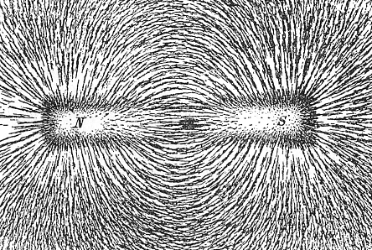
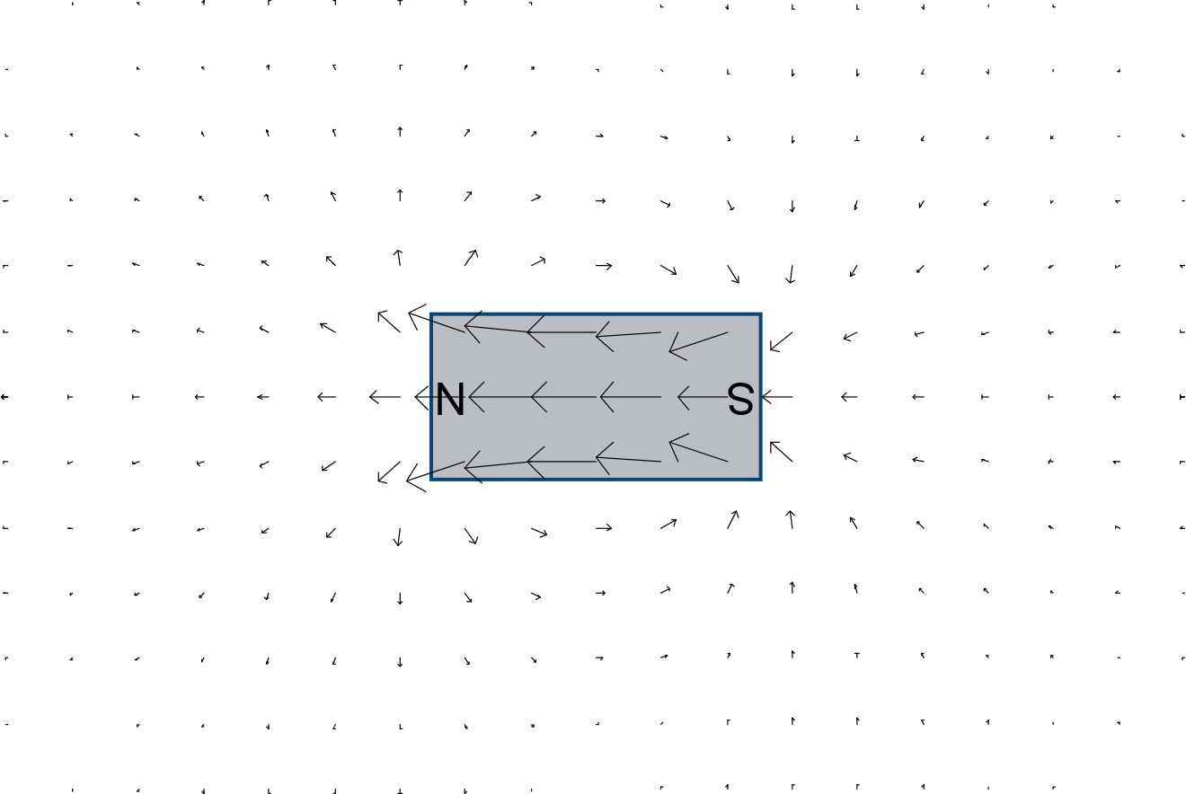
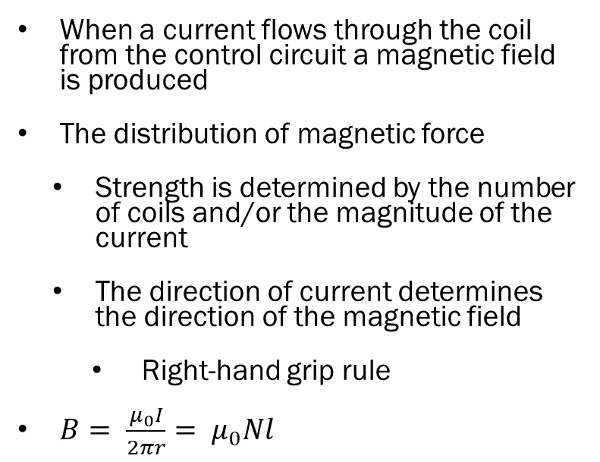
Coil – What is a Magnetic Field?
When a current flows through the coil from the control circuit a magnetic field is produced
The distribution of magnetic force
Strength is determined by the number of coils and/or the magnitude of the current
The direction of current determines the direction of the magnetic field
Right-hand grip rule
$B= \frac{μ_{0}I}{2πr}= μ_{0}Nl$

Slide 11
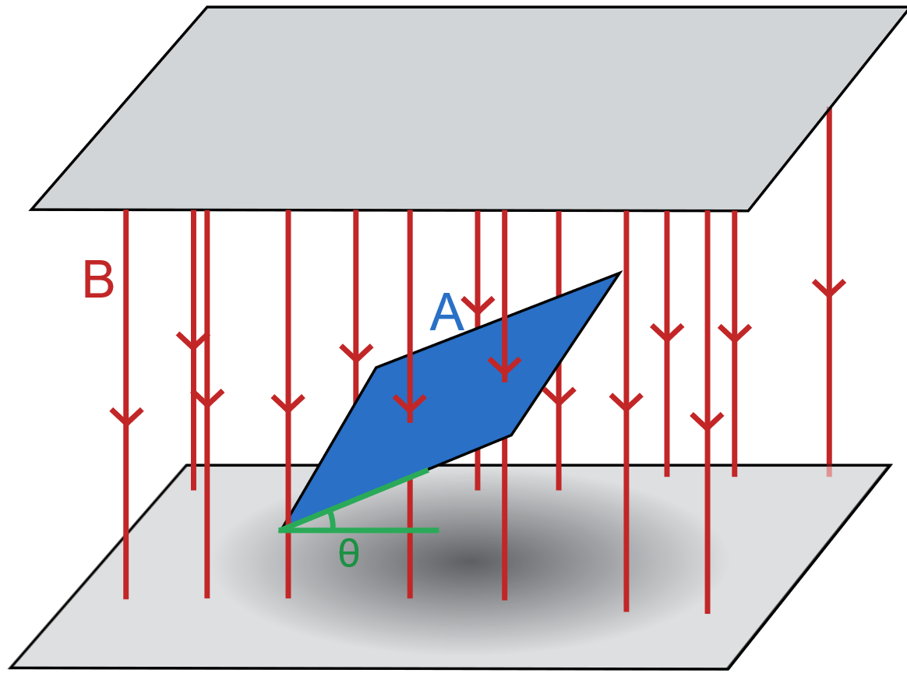
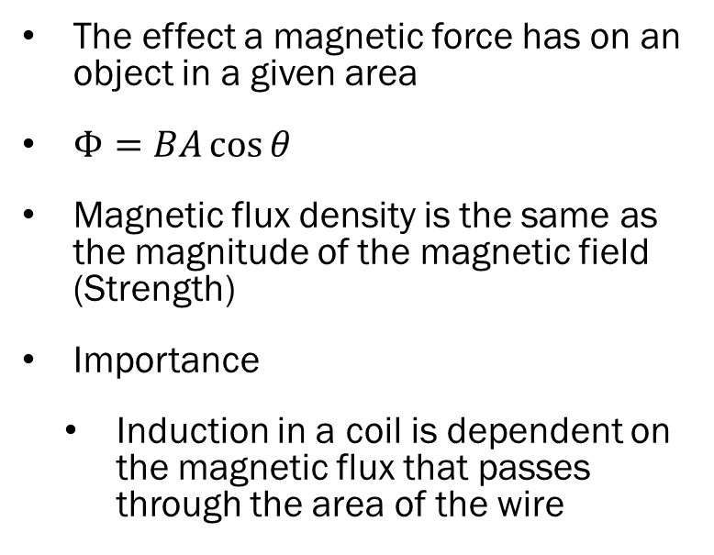
Coil – What is a Magnetic Flux?
The effect a magnetic force has on an object in a given area
$Φ=BA\cos{θ}$
Magnetic flux density is the same as the magnitude of the magnetic field (Strength)
Importance
Induction in a coil is dependent on the magnetic flux that passes through the area of the wire

Slide 12
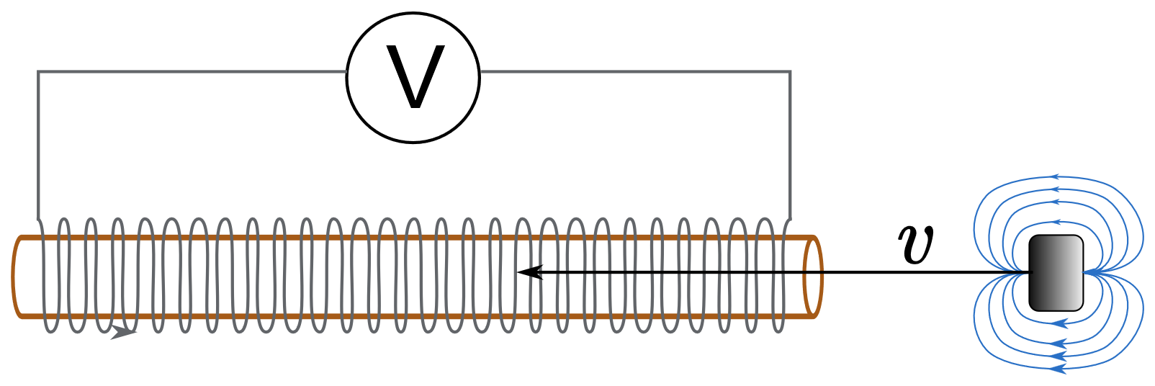
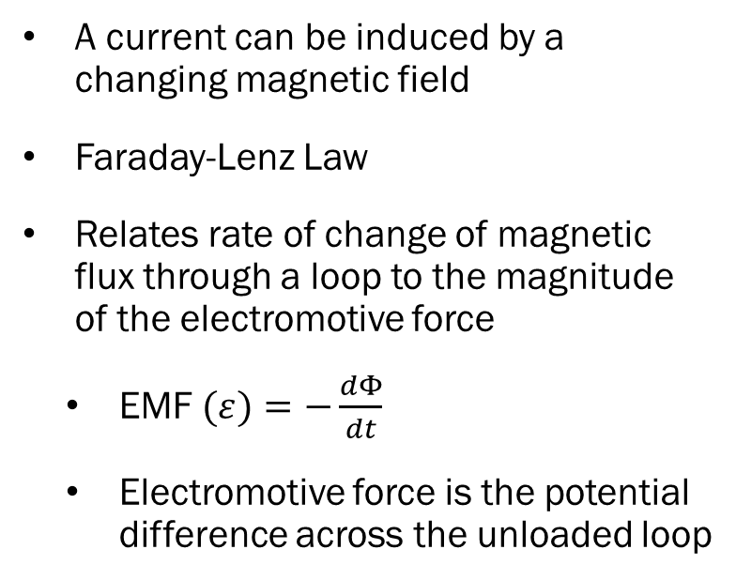
Coil – Electromagnetic Induction
A current can be induced by a changing magnetic field
Faraday-Lenz Law
Relates rate of change of magnetic flux through a loop to the magnitude of the electromotive force
EMF $(ε)=−\frac{dΦ}{dt}$
Electromotive force is the potential difference across the unloaded loop

Slide 13
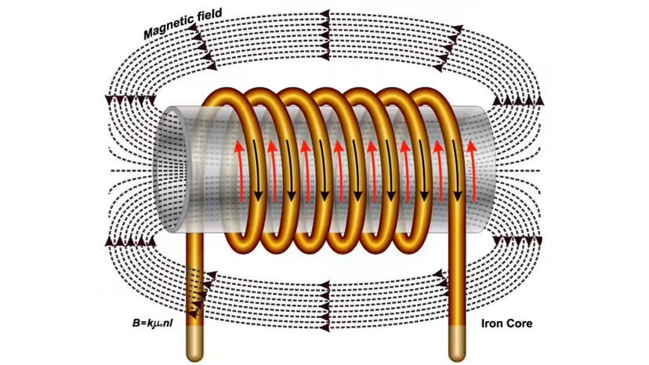
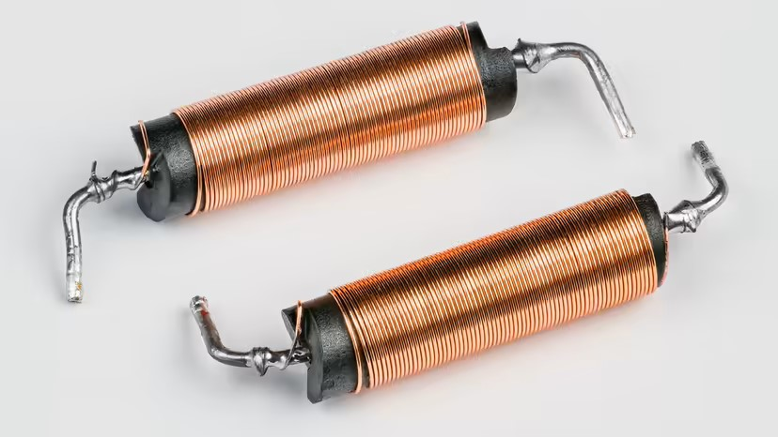
Coil – Electromagnetism
An electromagnet is a magnetic that is created via an electrical current
A coil of wire is wrapped around a metal core. With current flowing, a magnetic field is induced that magnetizes the core temporarily.
Strength is dependent on the current and/or the number of coils
That magnetic flux attracts the metal armature towards it

Slide 14
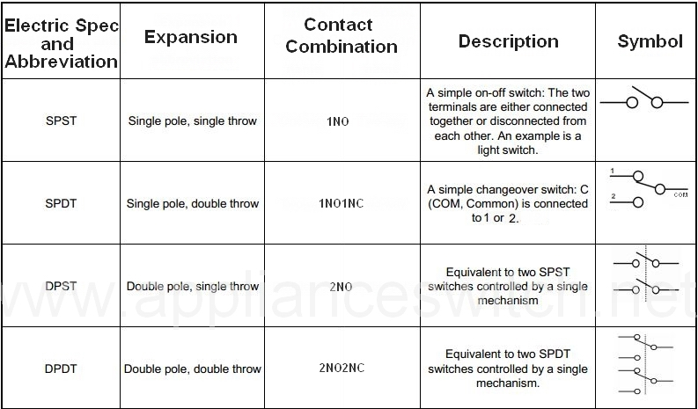
Single Pole Single Throw (SPST)
Normally Open (NO)
Normally Closed (NC)
Pole – Number of armatures
Throw – Number of load circuits per pole
Like a light switch

Slide 15
Single Pole Double Throw (SPDT)
Normally Open (NO)
Normally Closed (NC)
Pole – Number of armatures
Throw – Number of load circuits per pole
Like a toggle switch

Slide 16
Double Pole Single Throw (DPST)
Normally Open (NO)
Normally Closed (NC)
Pole – Number of armatures
Throw – Number of load circuits per pole
2 armatures controlling 1 load circuit each

Slide 17
Double Pole Double Throw (DPDT)
Normally Open (NO)
Normally Closed (NC)
Pole – Number of armatures
Throw – Number of load circuits per pole
2 armatures controlling 2 load circuits each

Slide 18
Application/Importance
Application
Control Systems – Used in places where high current and voltage equipment needs to be switched to ensure the safety of equipment and personnel.
Automotive – Used in various places in cars such as headlights, turn signal, and motor starter
Telecommunications – Used in signal routing and switching.
Importance
Electrical isolation
Can use a single control circuit for multiple load circuits
Reliable
Small
Can use low voltage to control a high voltage load safely

Slide 19
Thank you
Any Questions?

Slide 20
Sources
[1] Matan, “Electromechanical Relays | How it works, Application & Advantages,” Electricity - Magnetism, Oct. 26, 2023. https://www.electricity-magnetism.org/electromechanical-relays/
[2] “The Definition of SPST,SPDT,DPST,DPDT,1NO,2NO,1NO1NC,2NO2NC.-Push Button switch_Metal Push Button switch_Waterproof switch_Rocker switch_Micro switch_Temperature switch_Thermal protector_switch protector_heatsink fan_cpu cooler-Wainda Electronics Co.,Ltd.” http://www.applianceswitch.net/en/detail.php?nid=12
[3] “What are magnetic fields? (article) | Khan Academy,” Khan Academy. https://www.khanacademy.org/science/physics/magnetic-forces-and-magnetic-fields/magnetic-field-current-carrying-wire/a/what-are-magnetic-fields
[4] M. Brain, C. Pollette, and Y. Simón, “How Electromagnets work,” HowStuffWorks, Jul. 18, 2023. https://science.howstuffworks.com/electromagnet.htm
[5] M. Mancini, “How solenoids work,” HowStuffWorks, Jan. 13, 2023. https://science.howstuffworks.com/solenoid.htm
[6] “What is Faraday’s law? (article) | Khan Academy,” Khan Academy. https://www.khanacademy.org/science/physics/magnetic-forces-and-magnetic-fields/magnetic-flux-faradays-law/a/what-is-faradays-law
[7] “Electromechanical Relays - Relays - Basics Electronics.” https://ecstudiosystems.com/discover/textbooks/basic-electronics/relays/electromechanical-relays/
[8] T. Agarwal, “Electromechanical Relay Circuit Working with Applications,” ElProCus - Electronic Projects for Engineering Students, Jul. 29, 2015. https://www.elprocus.com/electromechanical-relay-working-with-applications/

